Slide 2
Biometrics
Something you are
Physical characteristics
Commonly added to 2FA

Slide 3
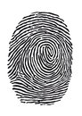
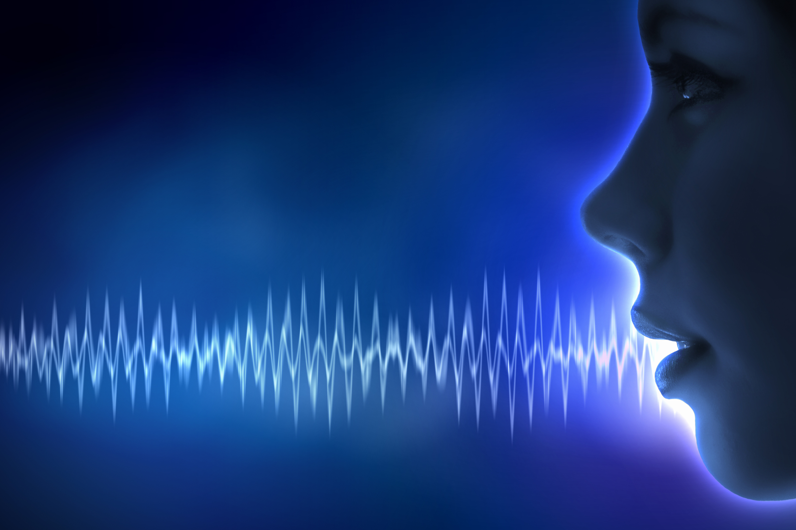
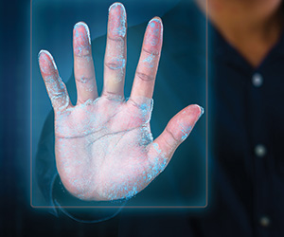
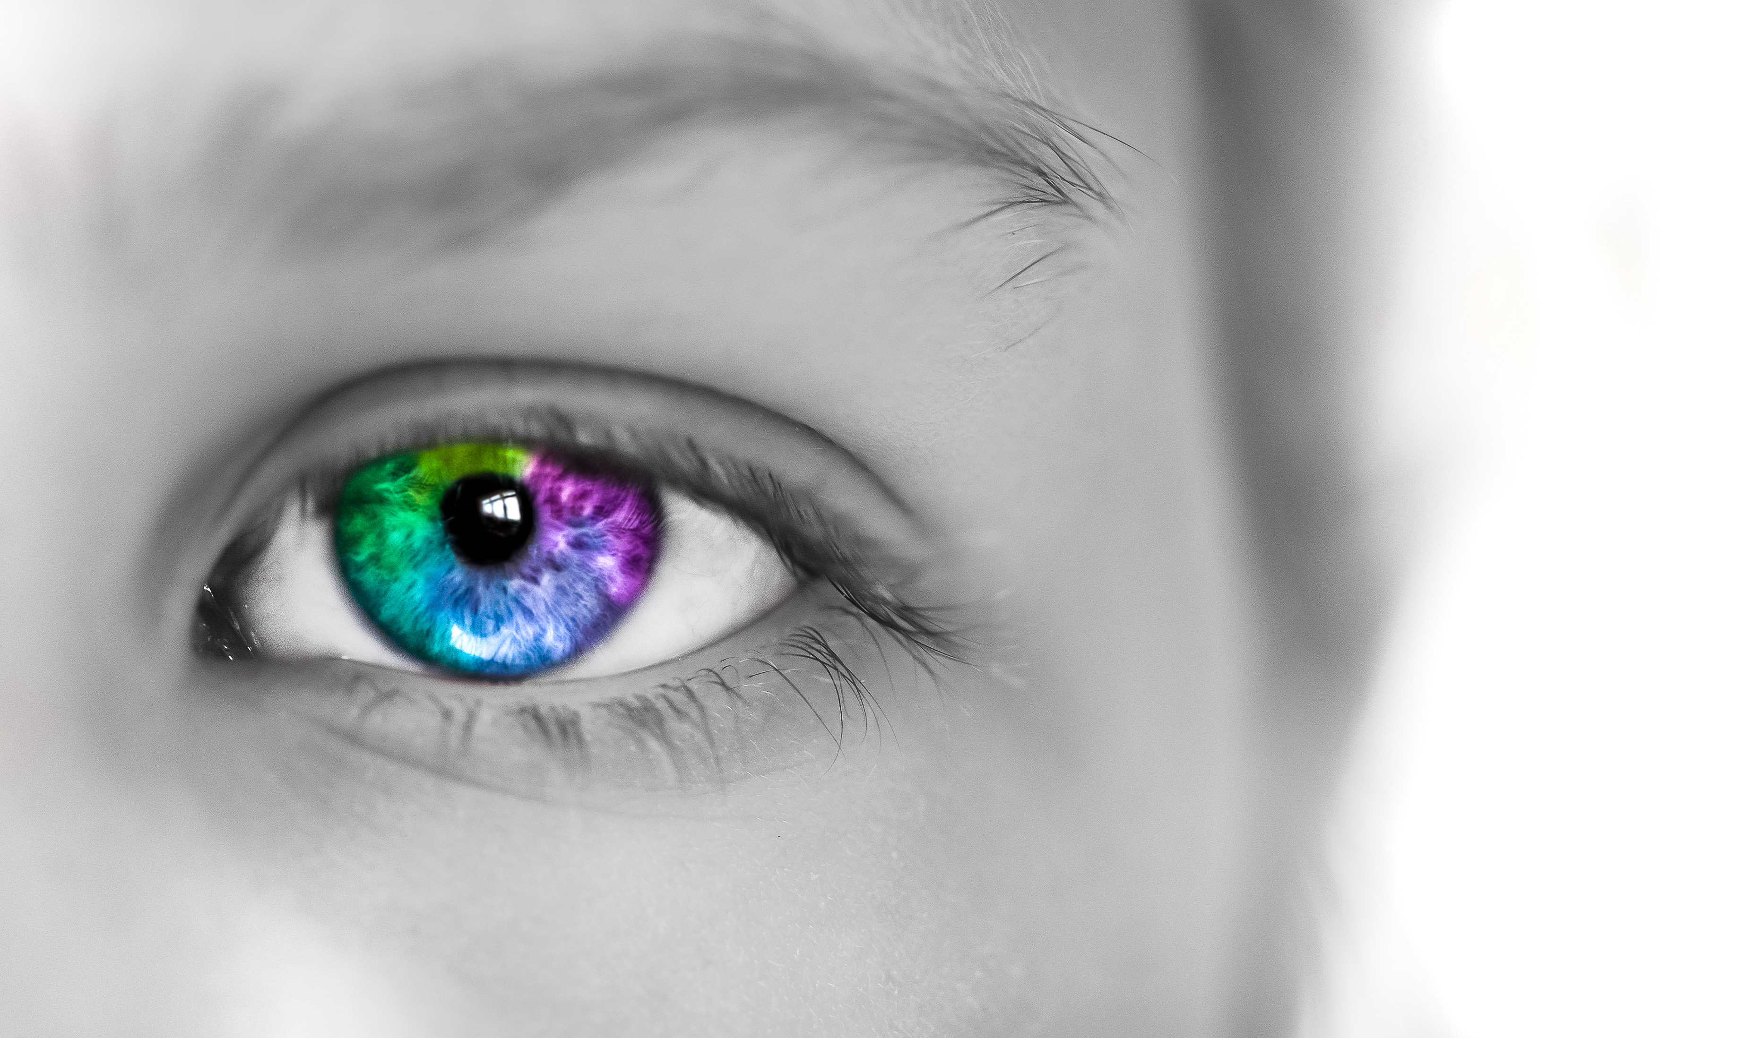
Biometrics Methods
Fingerprint
Voice
Hand Geometry
Retina and Iris

Slide 4

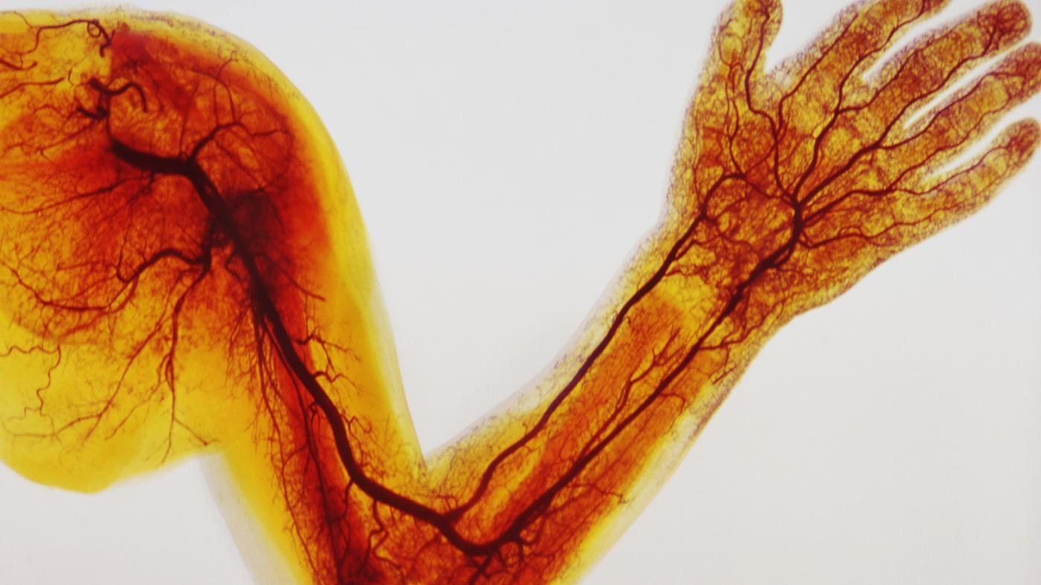
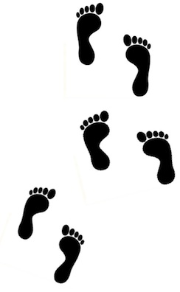
Biometrics Methods
Facial
Veins
Gait Analysis

Slide 5
Efficacy Rates
False Rejection Rate (FRR)
False Acceptance Rate (FAR)
Crossover Error Rate (CER)

Slide 6


False Rejection Rate (FRR)
Also called Type I error
Authorized users are rejected
Availability is lost
Notes:
Reduction in productivity
Cost to reauthentication
This is a frustrating error for authorized users but from a security standpoint, availability is lost but Confidentiality and Integrity are retained
Both errors cause issues but this is the better of the two

Slide 7


False Acceptance Rate (FAR)
Also called Type II error
Unauthorized users granted access
Confidentiality and Integrity are lost
Notes:
When an unauthorized user is granted access as though they are an authorized user then Confidentiality and Integrity cannot be guaranteed.
This is the worst of the biometric authentication efficacy error types

Slide 8
Crossover Error Rate (CER)
Also called Equal Error Rate (EER)
Describes the overall accuracy
FAR
FRR
Errors
CER
Sensitivity

Slide 9
Crossover Error Rate (CER)
System 1
System 2
FAR
FRR
Errors
CER
FAR
FRR
CER
Sensitivity

